Slide 1






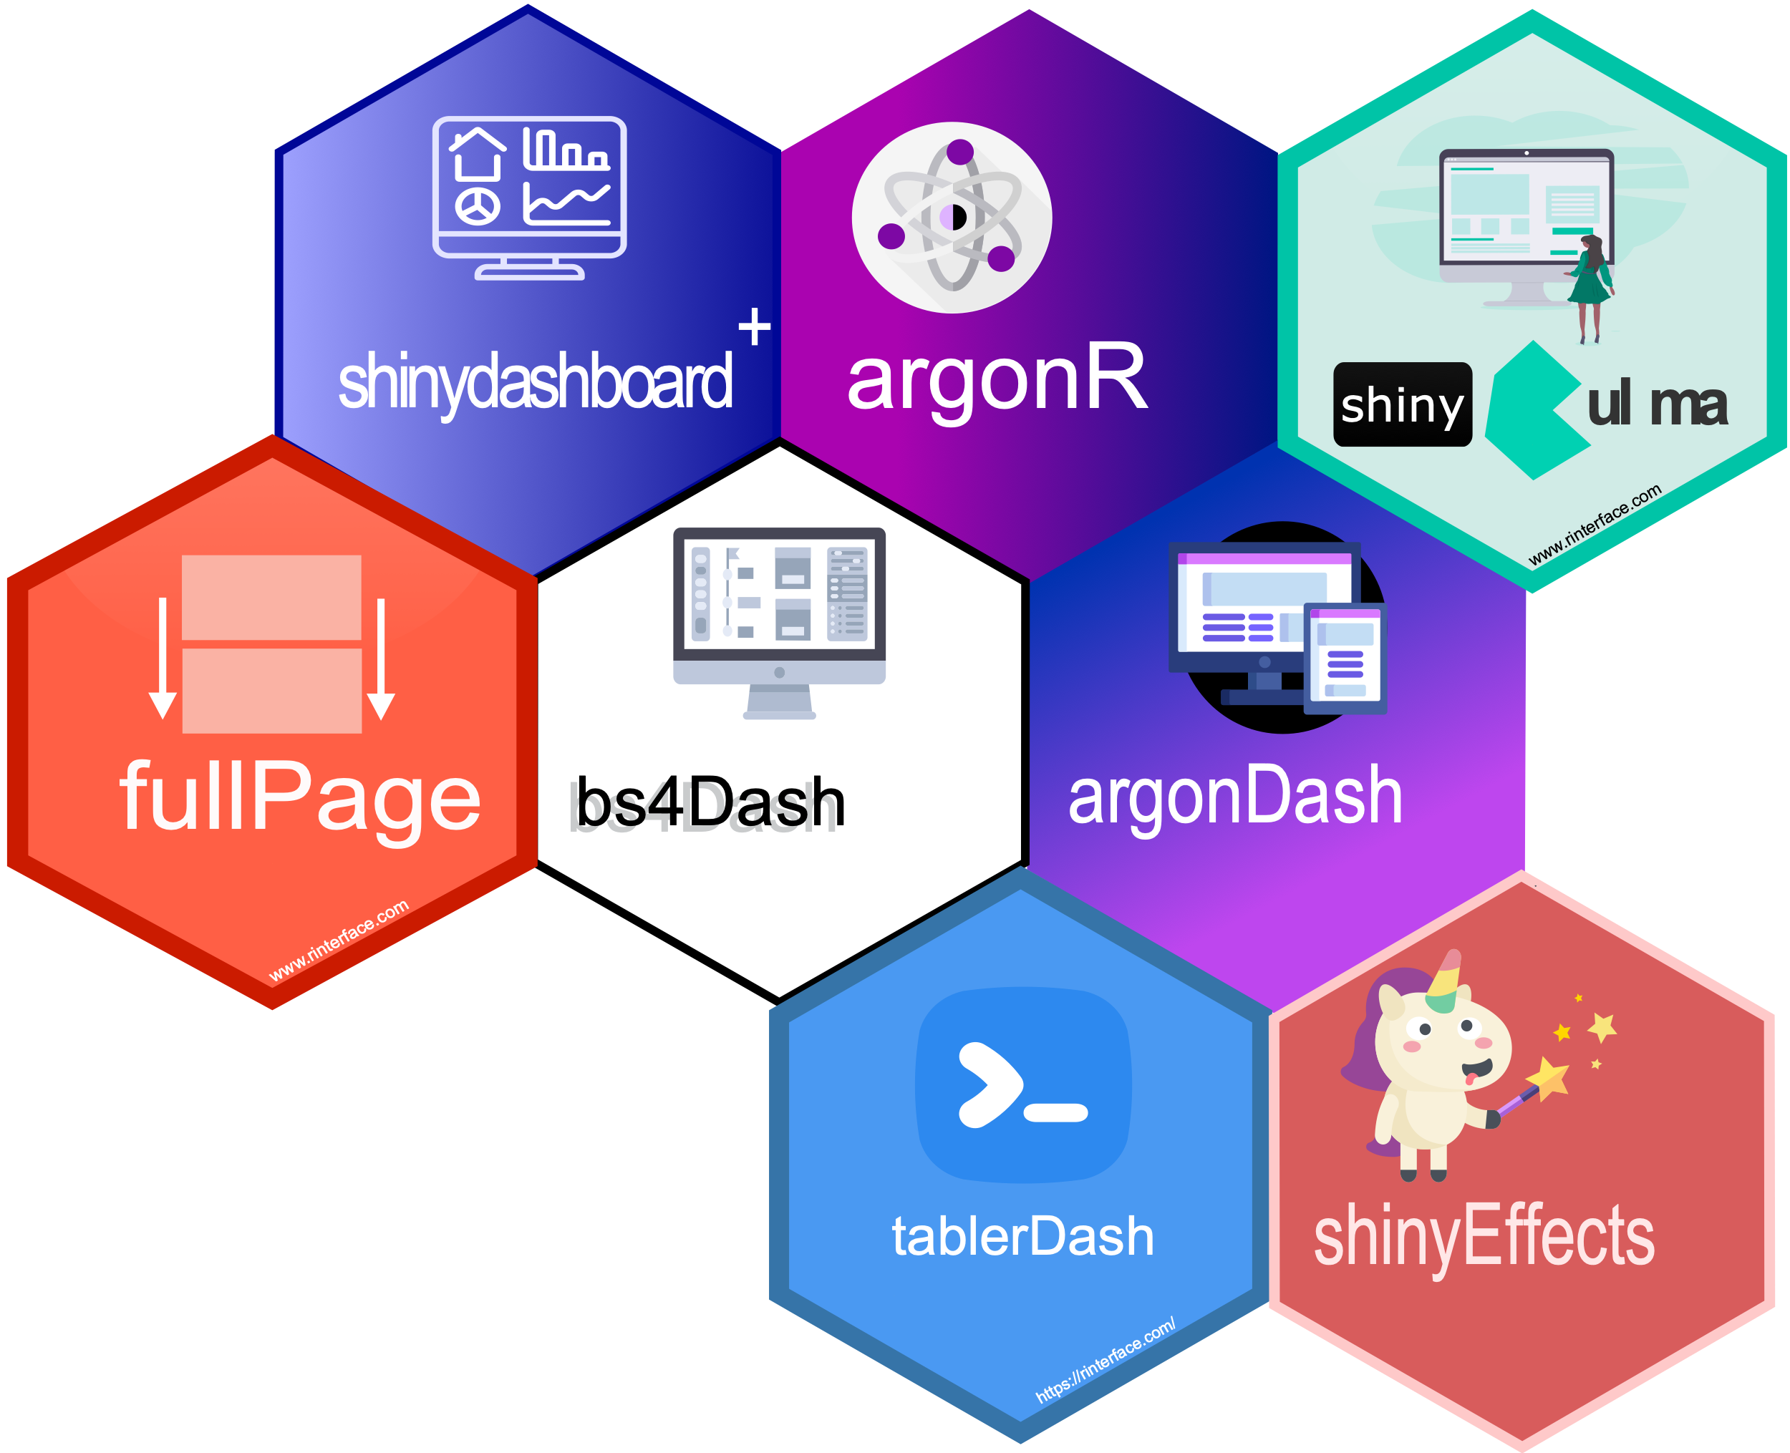

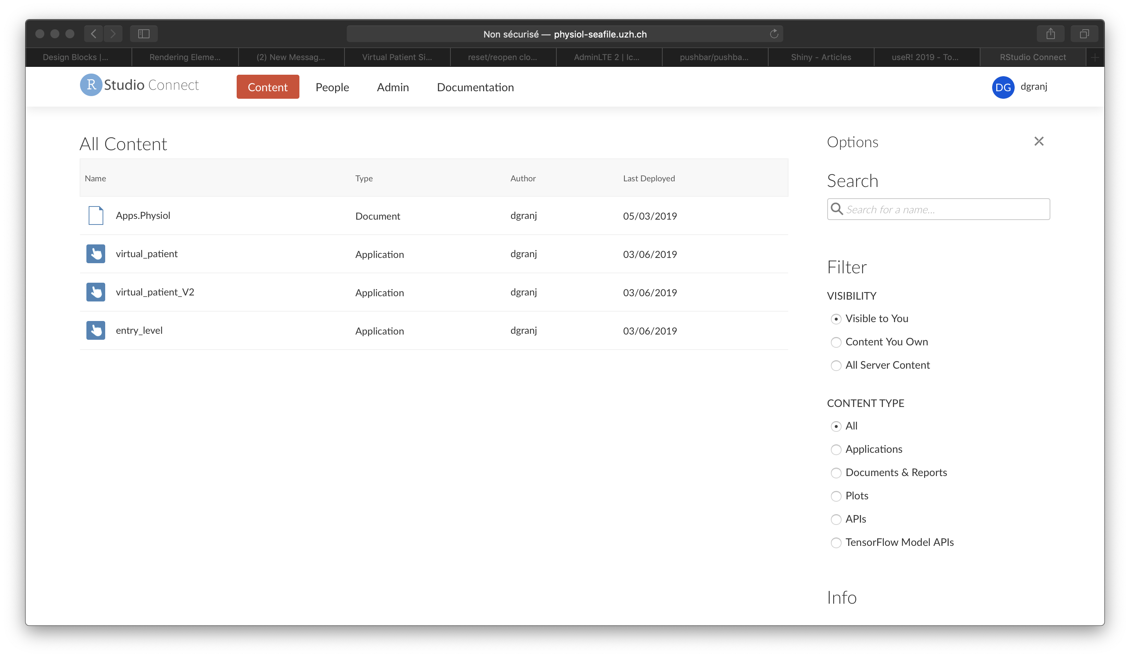
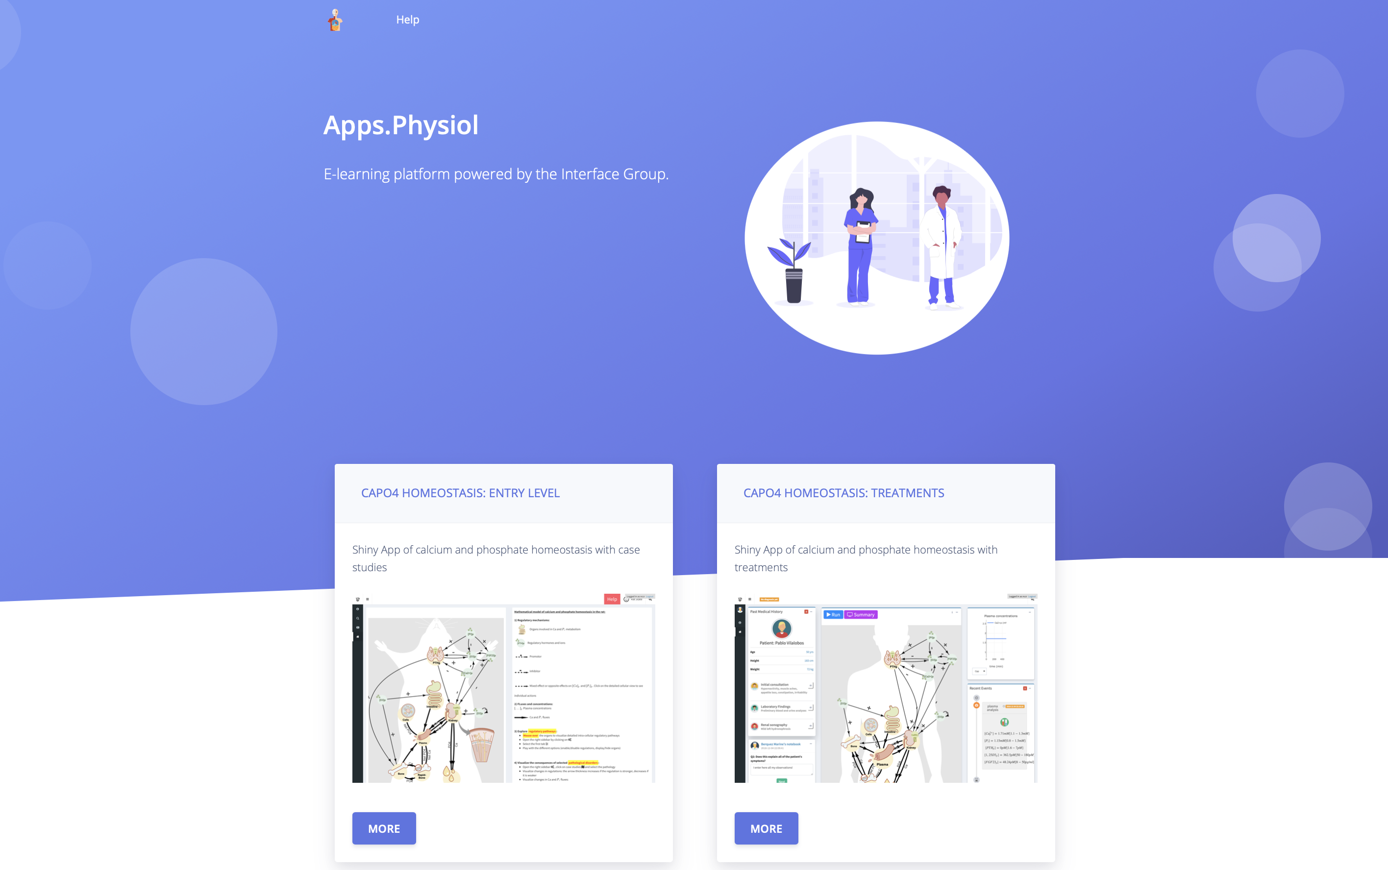
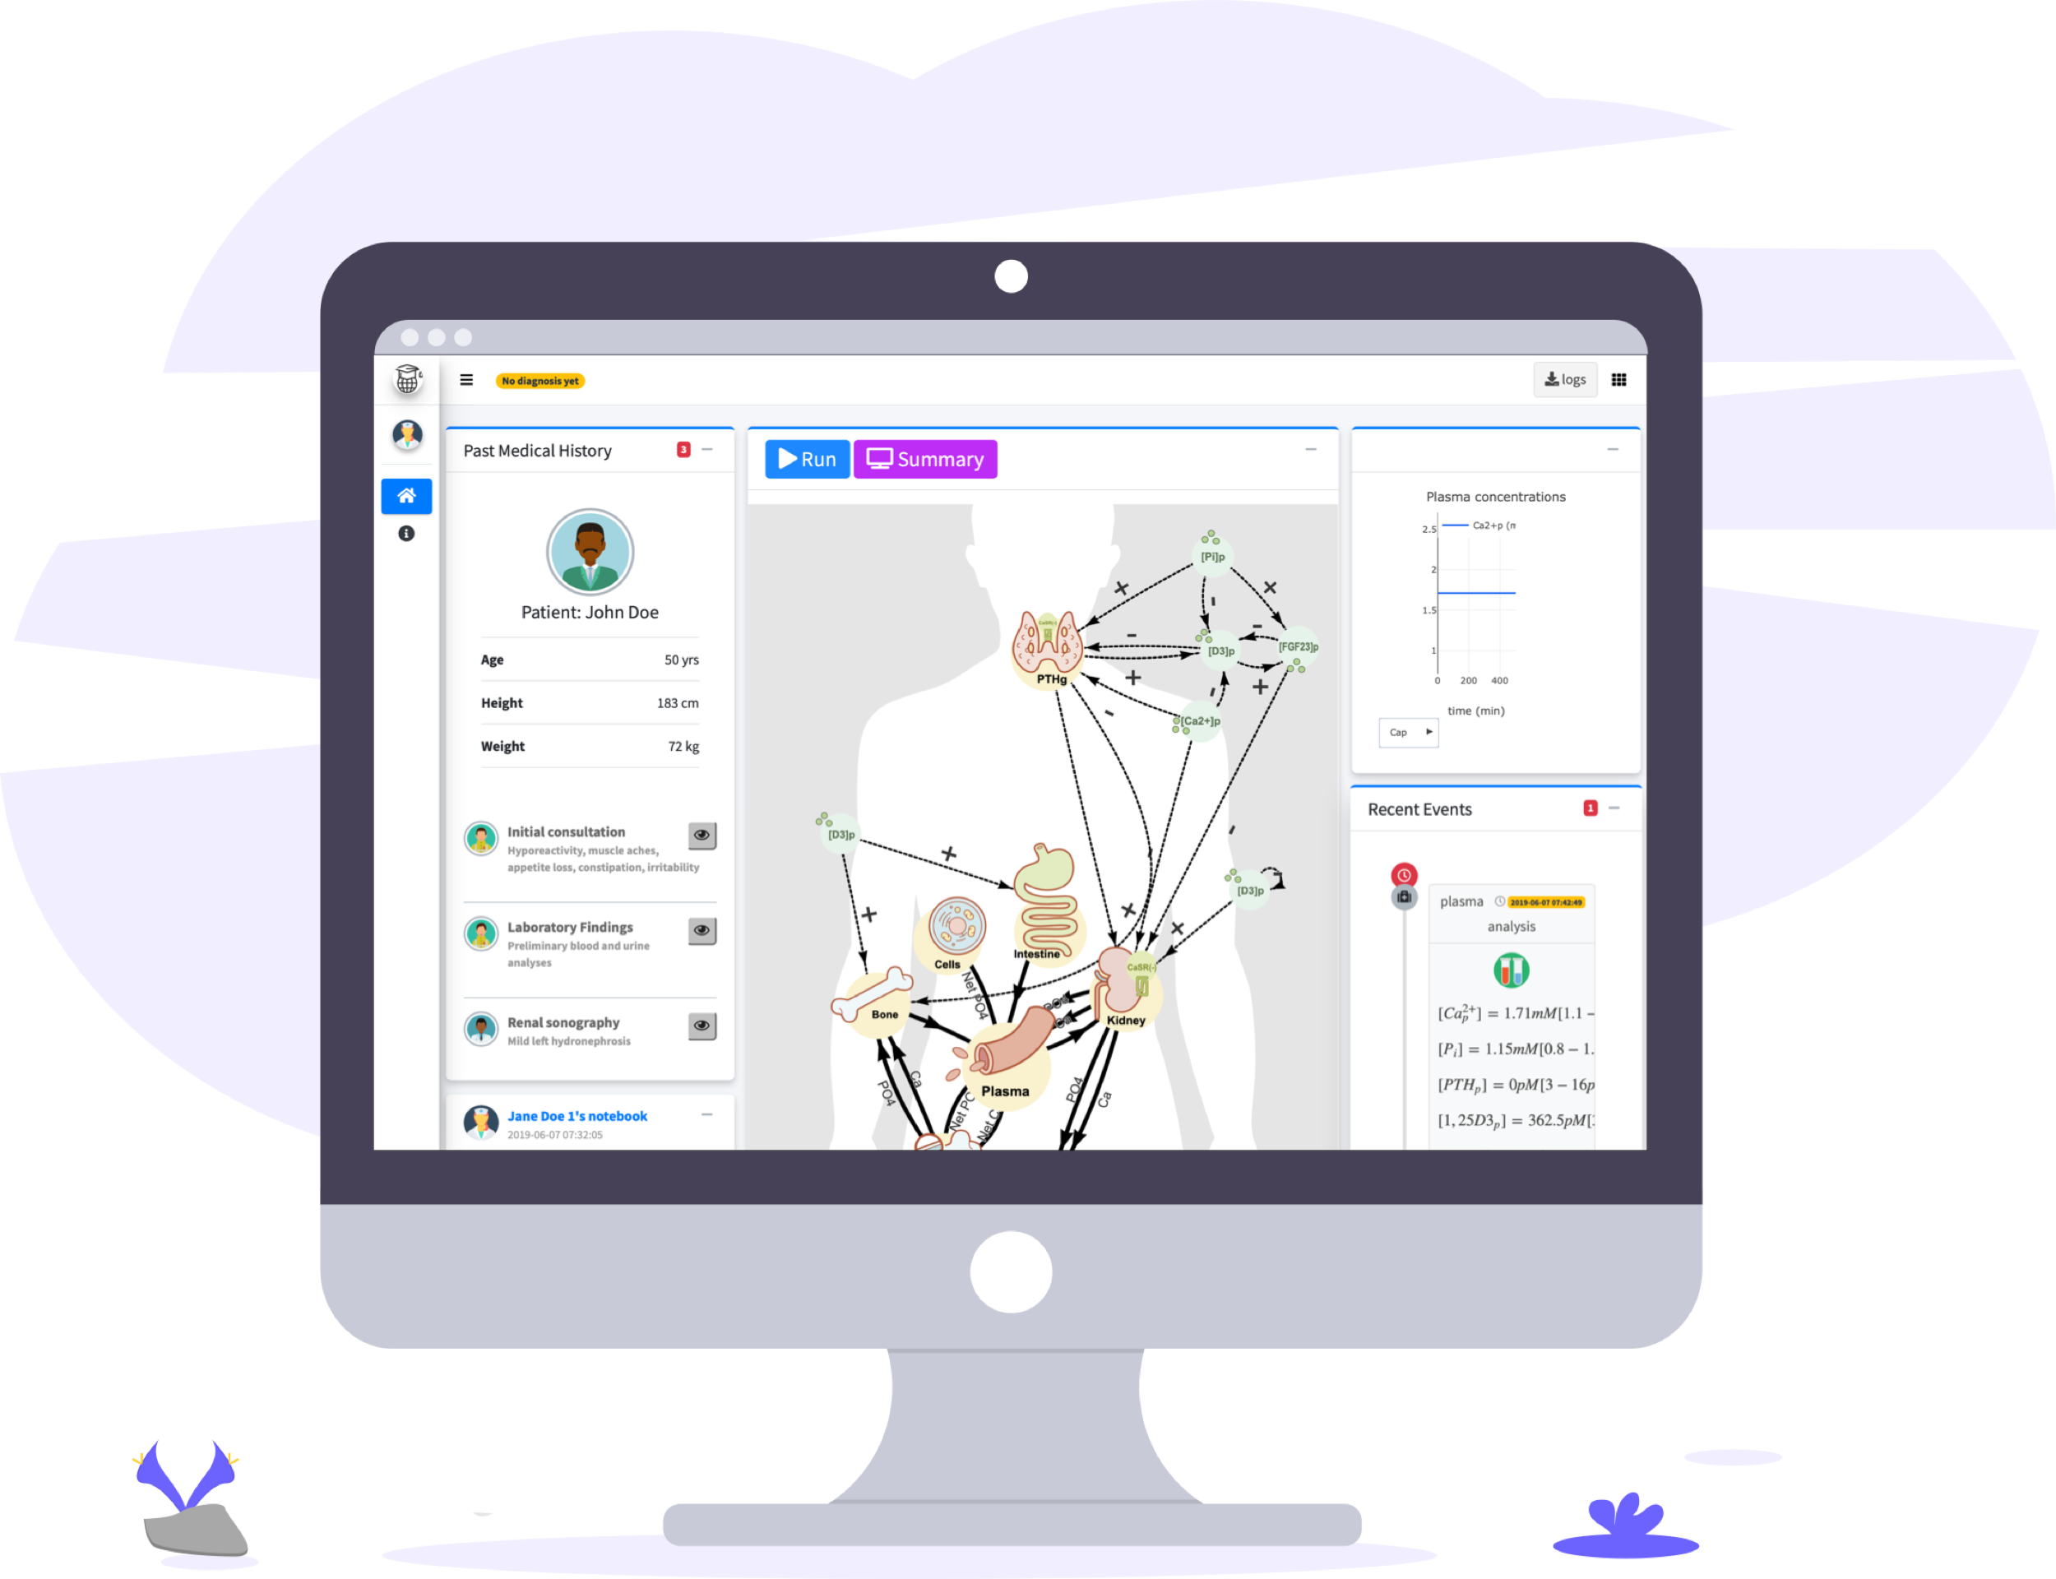
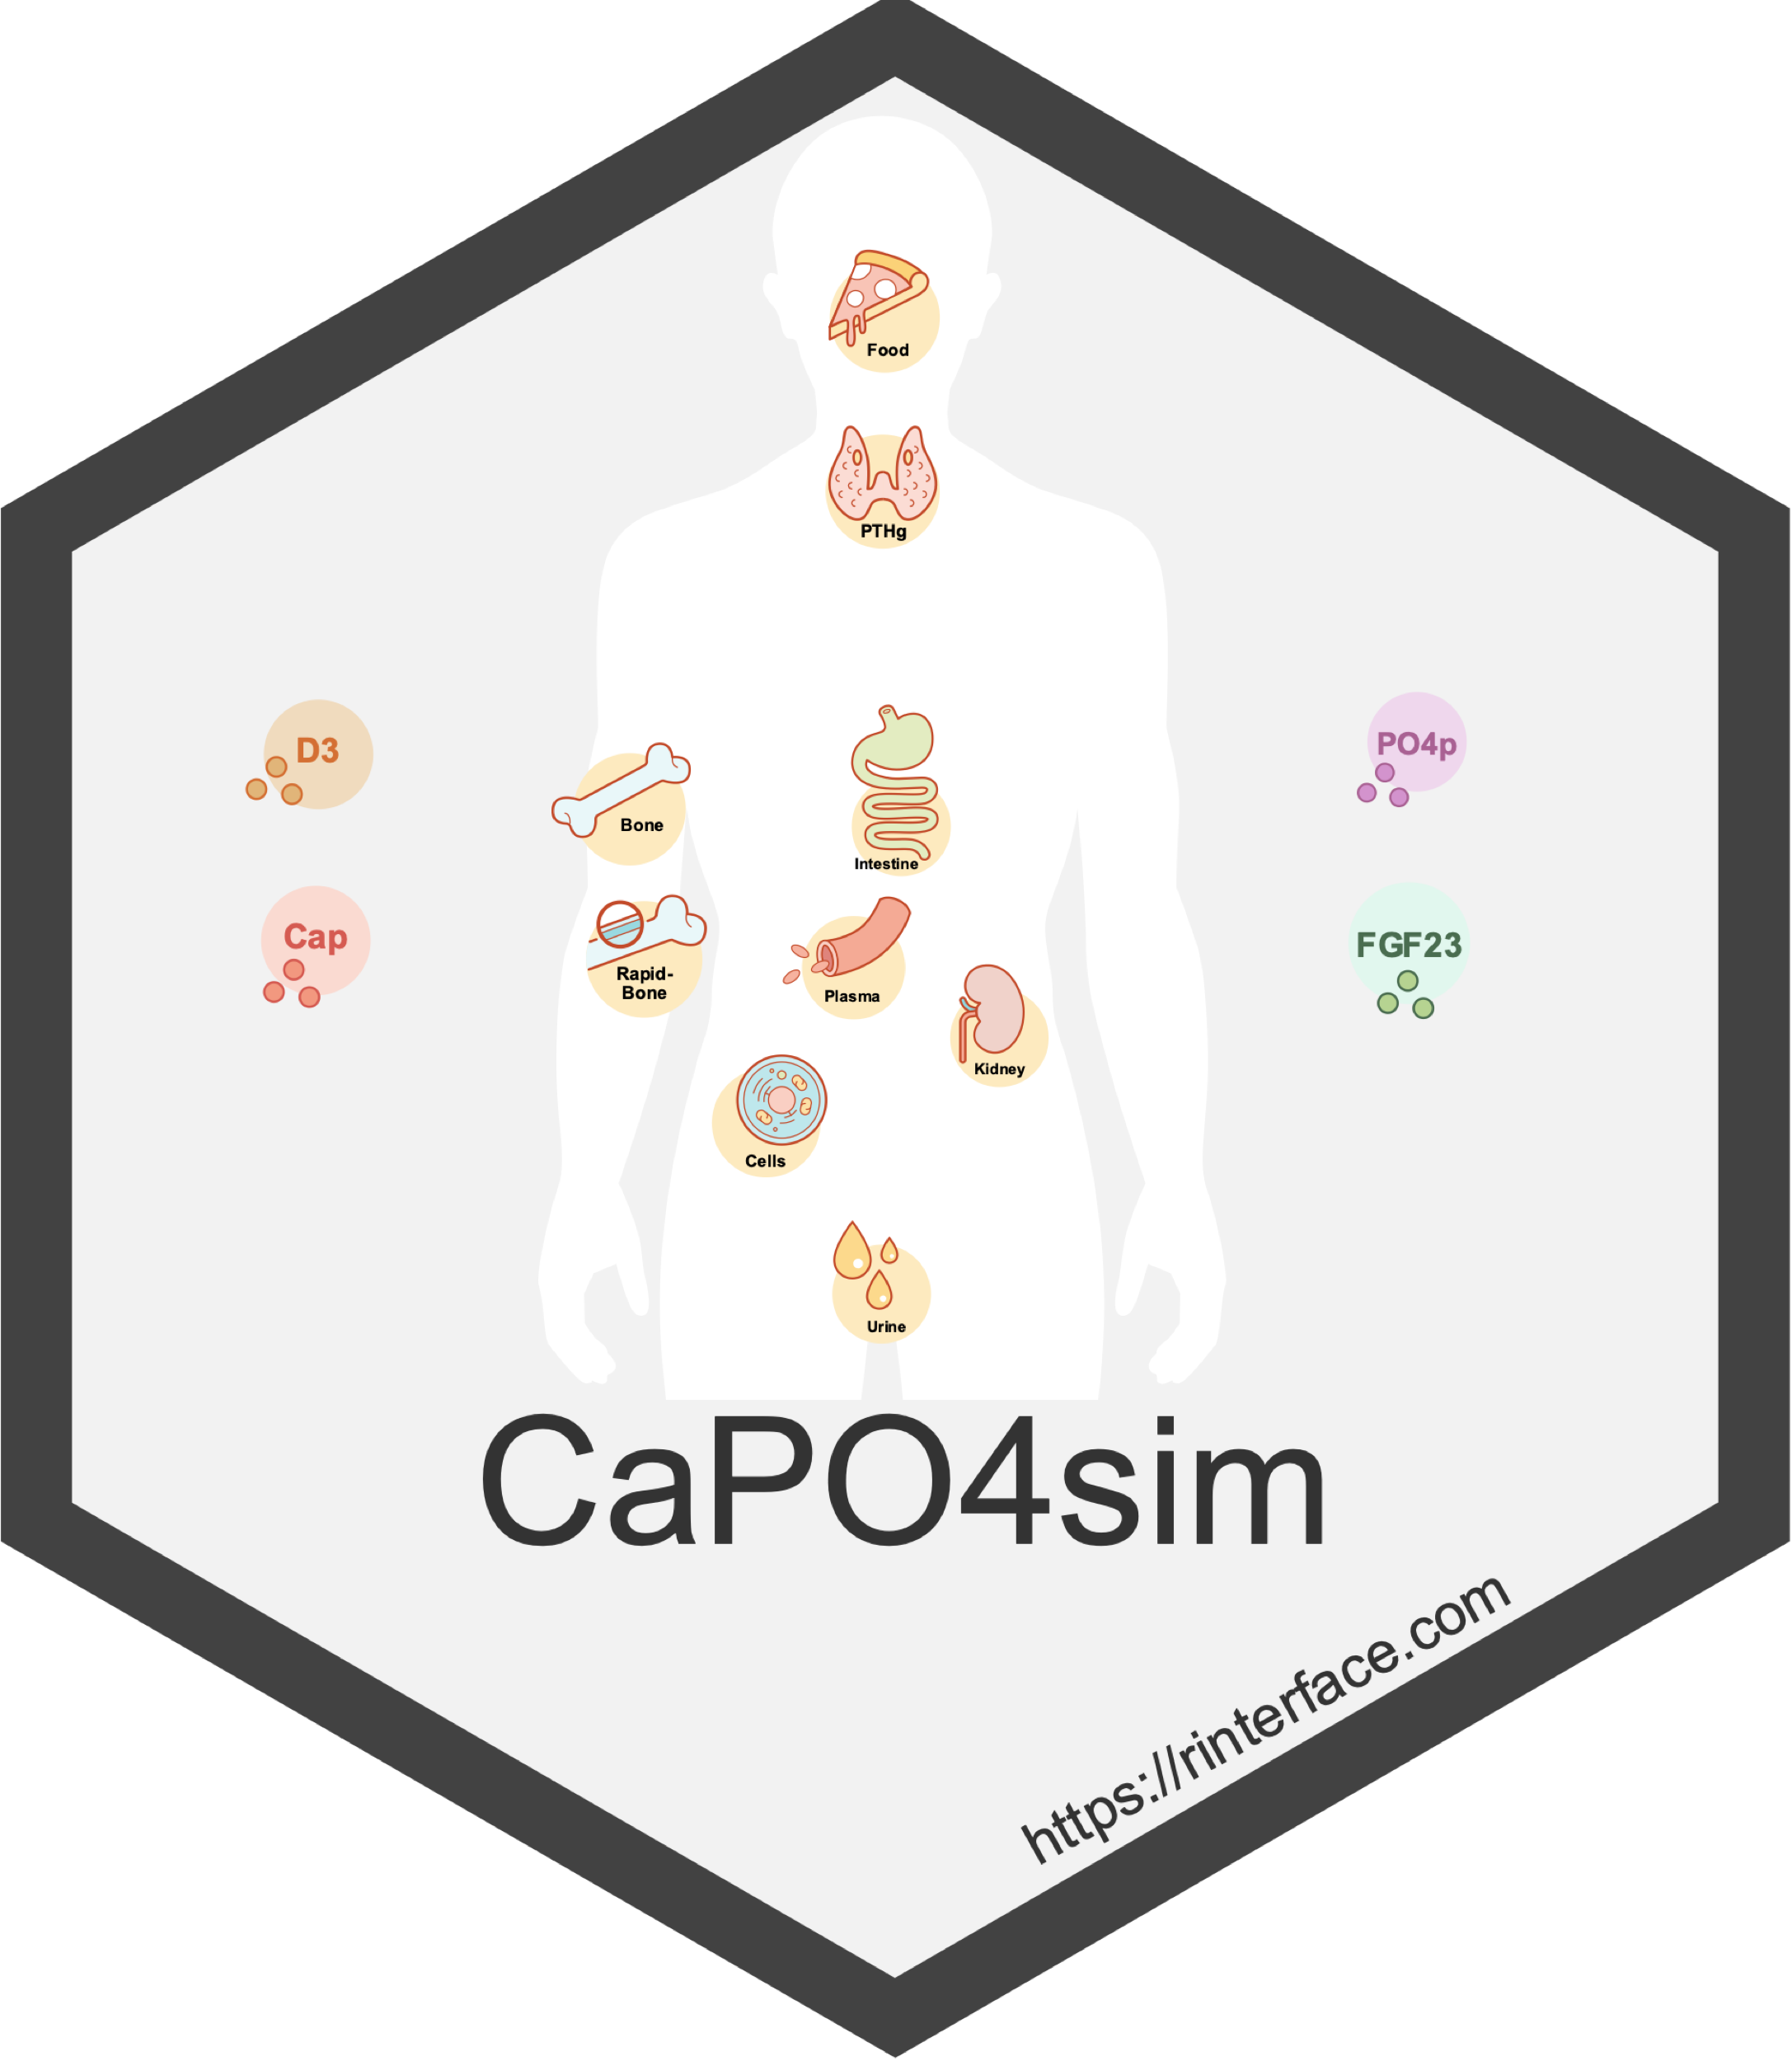




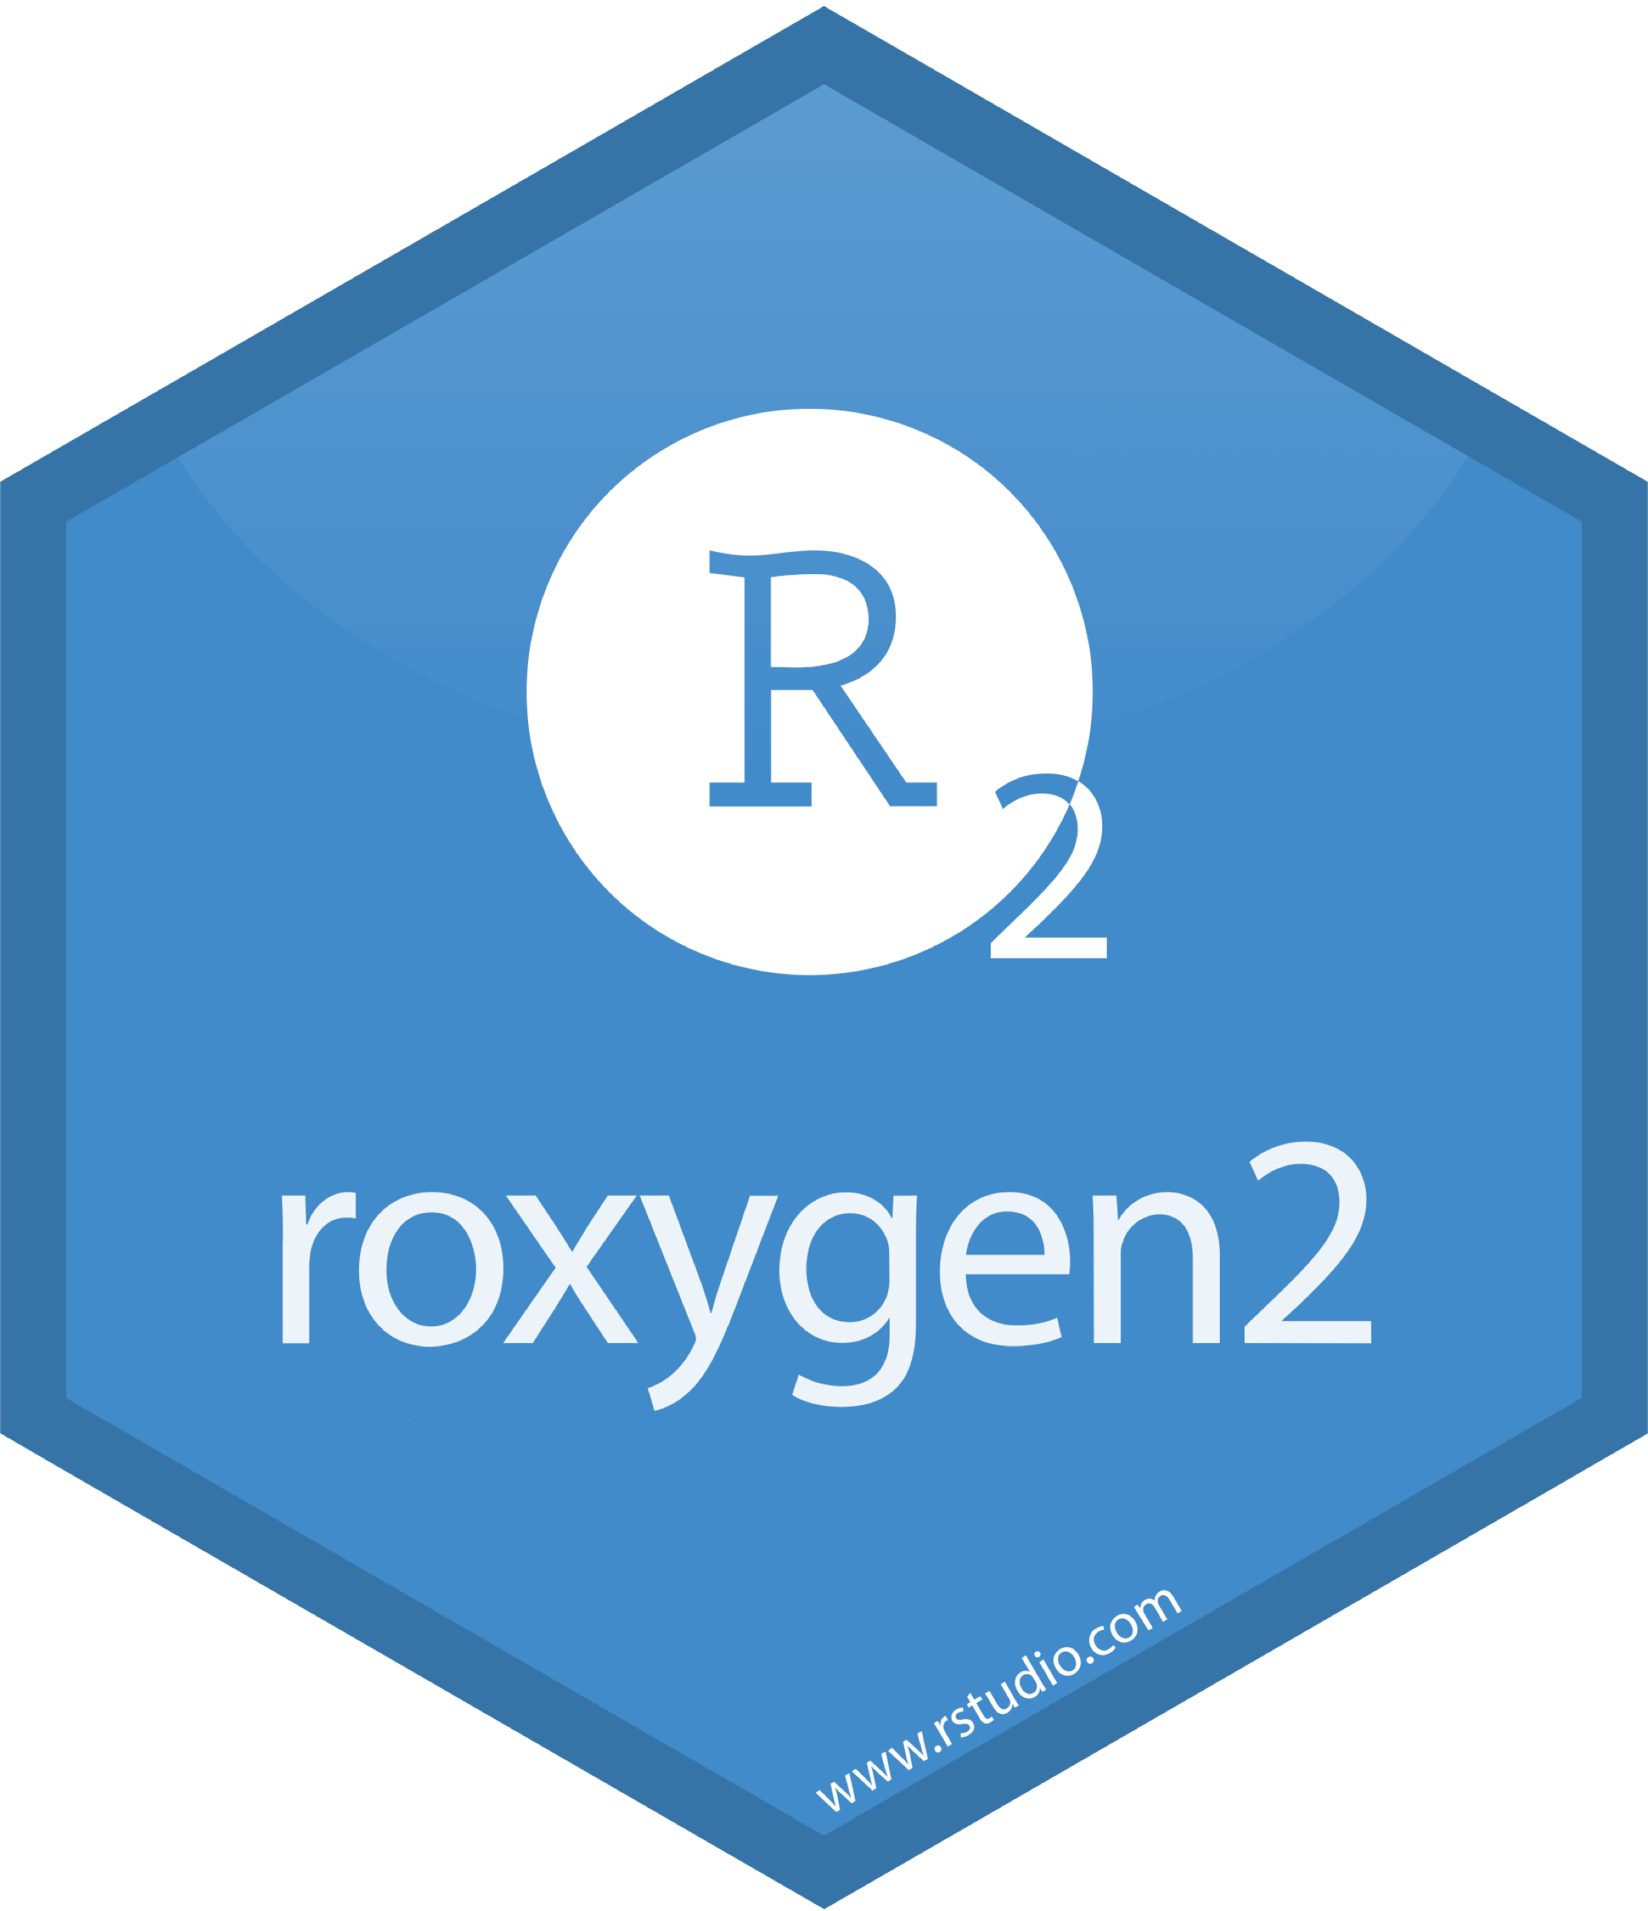
Web-based e-learning tools of Calcium and Phosphate Homeostasis.
David Granjon¹, Olivier Bonny², François Verrey¹, Vartan Kurtcuoglu¹ and Diane de Zélicourt¹
1. Institute of Physiology, University of Zurich, Zurich, Switzerland; 2. Département de Pharmacologie et Toxicologie, Université de Lausanne
Novel Shiny templates
Hosting
Objectives
To develop an interactive and participatory web-based eLearning tool allowing students to simulate physiologic function as well as pathologic changes in the control of Ca-P homeostasis, and thereby consolidate information conveyed in the lecture.
RinteRface provides a set of novel HTML templates to develop outsanding modern dashboards.
App Features
Basic principle:
Virtual patient study
Main workflow:
“Virtual patients” are randomly assigned or can be constrained by the teacher to a specific one (e.g. collaborative group work)
Carefully read the patient presentation
Establish diagnosis
Propose treatments
Easily extendable:
Possibility for the teacher to add a new virtual patient case
Outlook
This new tool is a first step toward:
Including more biological mechanisms
Developing more templates for shiny that can scale on all platforms (desktop, tablets, …)
Providing predictive apps to assist patients
TO FINISH
References
Granjon D, Bonny O and Edwards A. Coupling between phosphate and calcium homeostasis: a mathematical model. Am J Physiol Renal Physiol, 2017, 313: 1181-1199.

